Slide 1
RS: Week of 07/23 Update
Raja Selvakumar
7/26/18
eCAL

Slide 2
Agenda Overview
MATLAB: OCVR/OCVRRC results + discussion
Python: OCVR/OCVRRC update
DP writeup update
ADP OCVR formulation

Slide 3
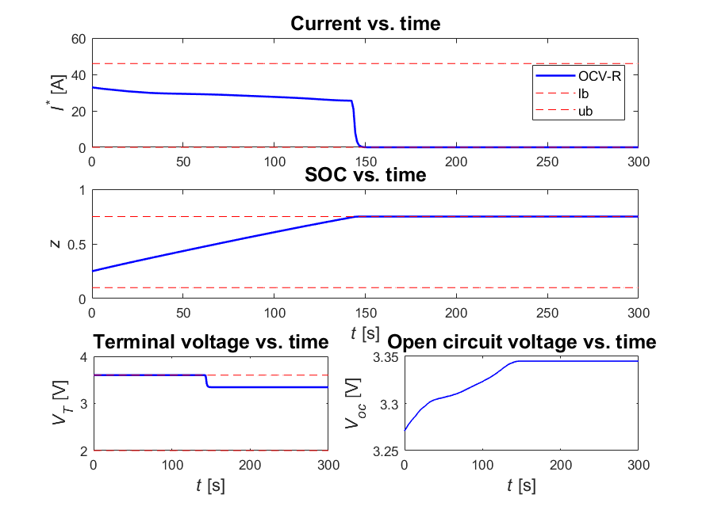
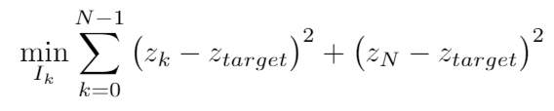
OCV-R: MATLAB
Specifications
z_{target} = 0.75
lb:
ub:
State(s): {z}
Control(s): {I}
Objective fn:
Remarks
Changing objective function has no impact on optimal control
DP time: 4.5-6.5 sec

Slide 4
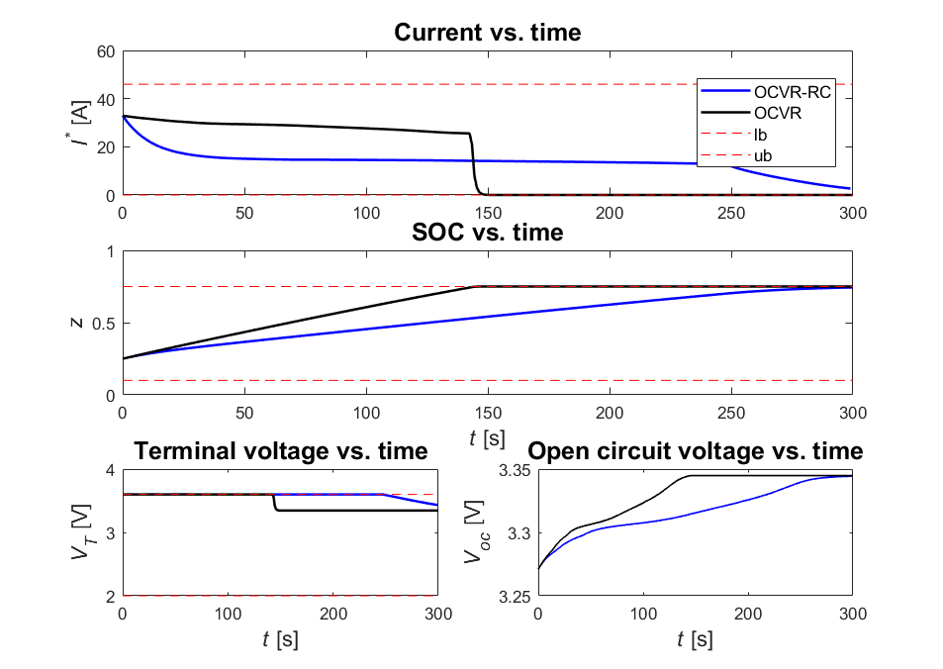


OCV-R-RC: MATLAB
Specifications
lb:
ub:
State(s): {z, V₁}
Remarks
Profile appears to be CV aside from some constraint that becomes active around 248s in a 300s simulation window
Current approaches 0 and SOC approaches target
DP time: 10 sec
Notes:
Main issue: what happens at 248s?

Slide 5
Python + writeup status report
[Python]
Code compiles and runs, but results aren’t correct
Comparing the DP outputs from MATLAB to Python show consistency
Simulation results show optimal current is just at 0. Interpolation is incorrect
DP takes 5 minutes to run
Start to parallelize the code (Ray)?
[Writeup]
Complete, addresses recent HEP comments
Notes:
Main issue: finding appropriate limits to iterate over for V1

Slide 6

ADP Sample Algorithm: OCV-R
[Step 1: Actor update to obtain u*]
Step forward in time to obtain optimal control policy at each time step k
Note all literature shows infinite time horizons, but we can use a finite time horizon [1]
[Step 2: Critic network to obtain J^]
One step approach to calculate J^ using NN
α = 0.9, r = min SOC error obj fun
Notes:
[1] https://ris.utwente.nl/ws/portalfiles/portal/5134989/wp_495.pdf

Slide 7
ADP Algorithm Block Diagram
Grad desc
update critic weights
w _{c,k+1}
x_{k}
Critic
Neural Network 1
J_{k}^
Maximize reward
Need r(x_{k},u_{k})
From DFN
u_{k}
DFN
J_{k}^
EXP
x_{k}
Actor
Neural Network 2
Minimize J_{k}^
u_{k}*
From DFN
u_{k}
To experiments
w _{a,k+1}
Grad desc
update actor weights
Notes:
k denotes each individual time step
ADP assess how good the function approximation is close to the desired reward

Slide 8
ADP/RL/DP Workflow Comparison
DP
ADP
RL
Step 1: Construct state and control space (x,u)
Step 2: Policy search (u*)
Iterate backwards in time
Construct entire state and control space
Bellman’s Principle: recurvisely determine optimal control strategy for given value function
Notes:
[1] https://ris.utwente.nl/ws/portalfiles/portal/5134989/wp_495.pdf

